Slide 1

Mars Seasonal South Polar Atmospheric Dust Opacity and Distribution
Drew Wasikoski of NAU
Mentored by Dr. Timothy Titus of the USGS

Slide 2
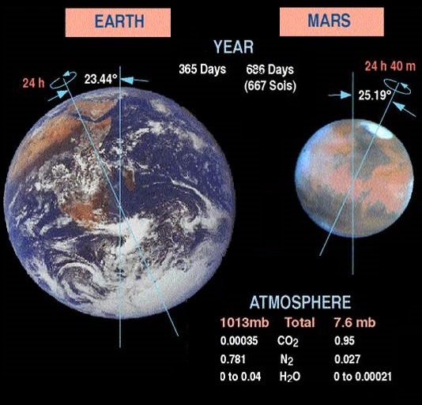
Background
Similarities to Earth:
    Similar Tilt → Seasons
Differences from Earth:
    CO₂ polar caps
    25% atmosphere cycled through polar caps annually
Mars Year (MY)
    1.9 Earth Years
  MY 1 = 1955

Slide 3
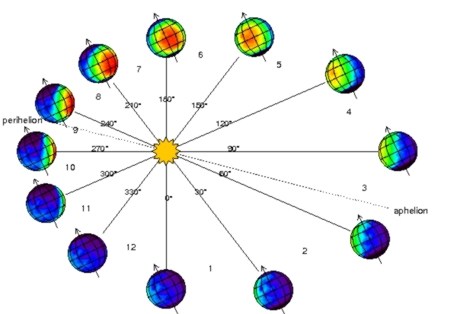
Defining Season (L_{s})
Southern Spring
(Northern Autumn)
Southern Winter
(Northern Summer)
Southern Summer
(Northern Winter)
Southern Fall
(Northern Spring)

Slide 4
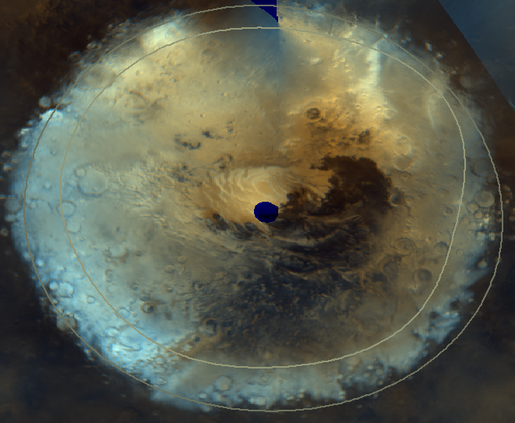
South Polar Cap
South Seasonal Cap
  Two Climate regions
    Bright
      Snow
    Dark
      Transparent Ice
      Dirty Ice
Cap Sublimes in the Spring
*Photo courtesy of Glen Cushing

Slide 5
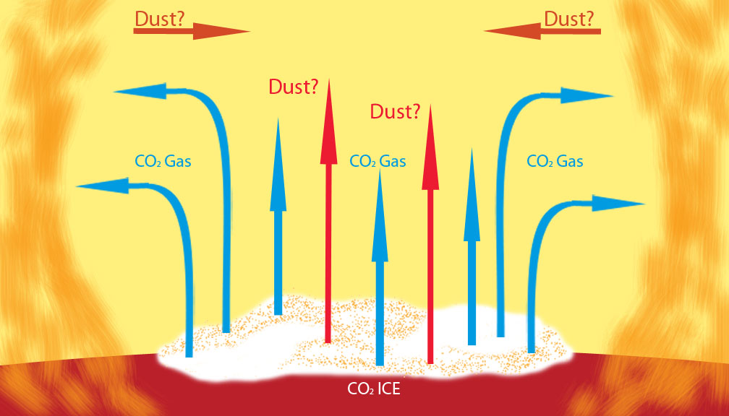
Spring Sublimation
Sublimation of Cap
  May bring dust from ice surface into atmosphere
  Creates over pressurized zone which could keep atmospheric dust out
How much atmospheric dust is over the cap?

Slide 6
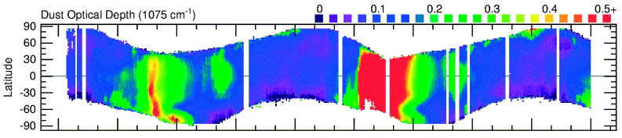
Dust Opacity
When analyzing atmospheric dust opacity we look at the band depth of the 9 µm wavelength
The most commonly used method for collecting opacity data is the Nadir technique
(looking straight down at the surface as you fly over)
Nadir fails over cold surfaces and thus Smith gets gaps in his results
*Smith [2003]

Slide 7
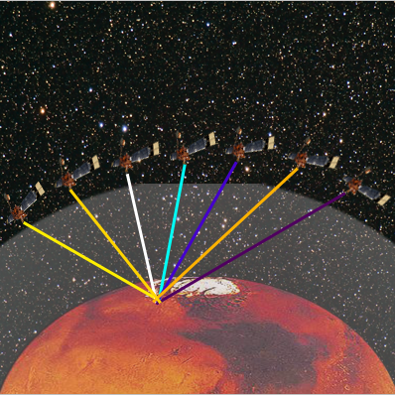
Data
Emission Phase Functions (EPF)
Extinction Curve in reverse
EPF sequence allows for separation of surface and atmospheric components
EPFs taken by Mars Global Surveyor (MGS) Thermal Emission Spectrometer (TES)
    Data taken during MY 24 and 26

Slide 8
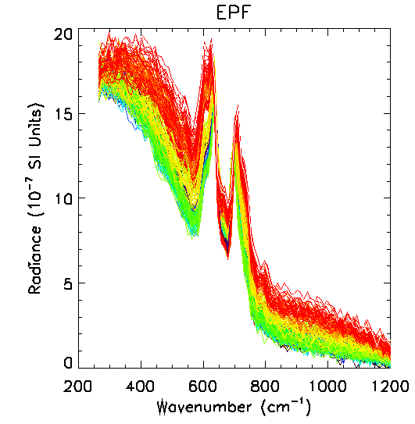
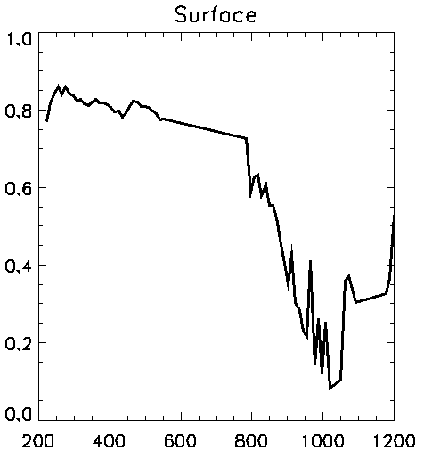
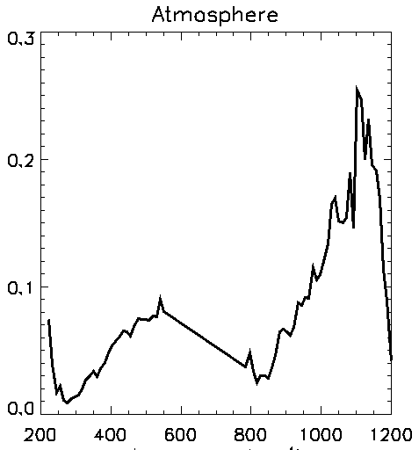
The Procedure
Find EPF Data
Catalog usable EPFs
Process EPFs into Surface and Atmospheric Components
Wavenumber (cm⁻¹)
Emissivity
Opacity
Wavenumber (cm⁻¹)
Wavenumber (cm⁻¹)

Slide 9
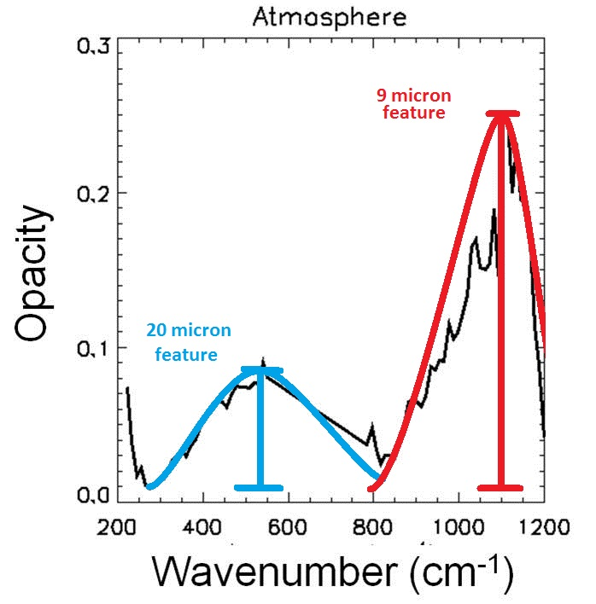
Atmospheric Analysis
Band Depths of 9 μm and 20 μm features determined
9 µm Band Depth is a proxy for Atmospheric Dust Opacity
Compared our dust opacity distributions to previous results
Dust opacity results above the over pressurized cap

Slide 10
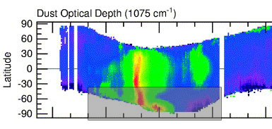
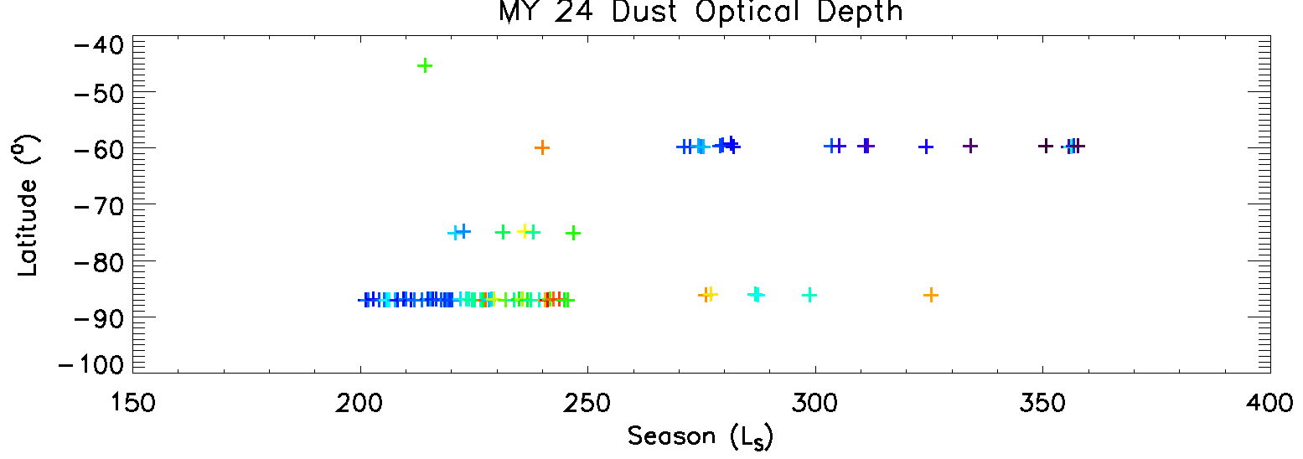
MY 24 EPF Comparison
Both data sets taken during Mars Year 24 with MGS TES
Smith used Nadir imaging technique to acquire his data
We used EPF collection technique to acquire our data
Plotted Opacity
Low → Medium → High
*Smith [2003]

Slide 11
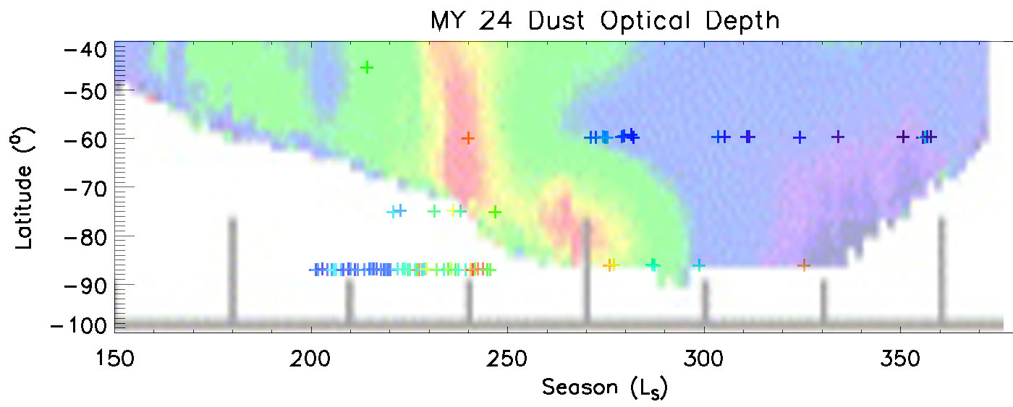
Results of MY 24 EPF Comparisons
Overlapping sections correlate extremely well
    Our TES EPF data is consistent with TES Nadir data
EPF data stretches further into colder regions
    EPFs can measure opacities in regions where Nadir fails
    We see signs of dust penetrating into the polar region

Slide 12
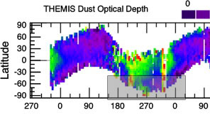
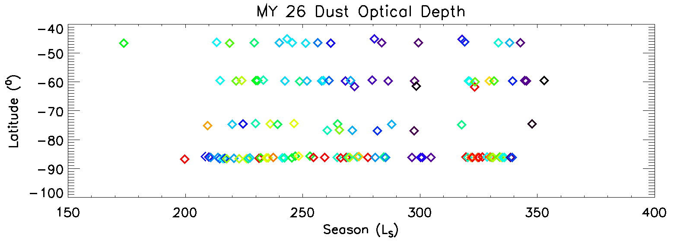
MY 26 EPF Comparisons
Both data sets taken during Mars Year 26
Smith used THEMIS data taken by Mars Odyssey using the Nadir Technique
We used TES data taken by MGS using EPF technique
Plotted Opacity
Low → Medium → High
*Smith [2009]

Slide 13
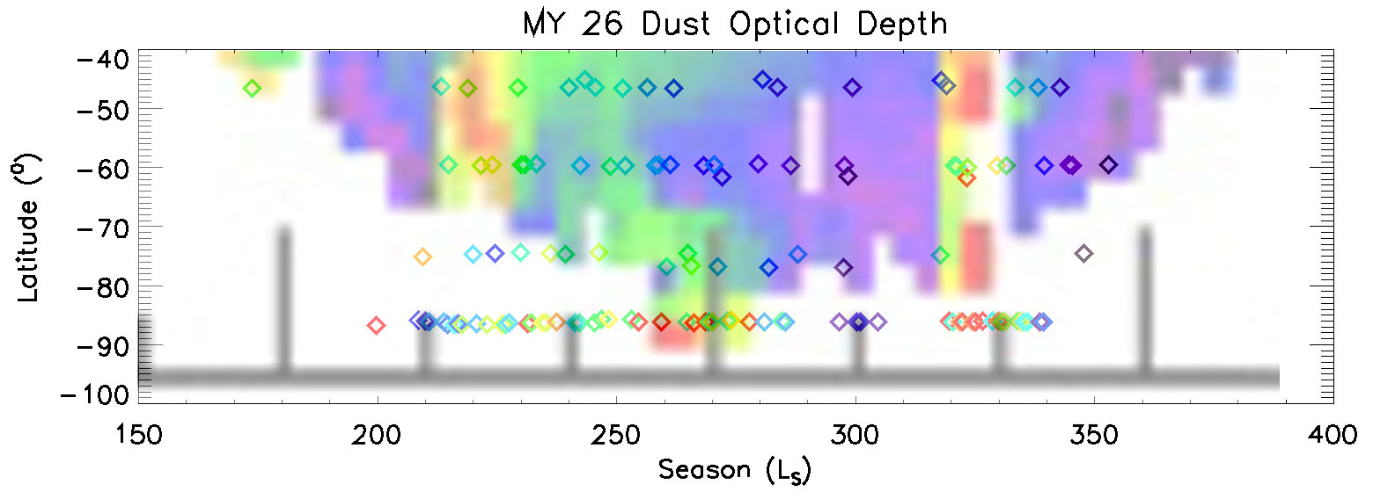
Results of MY 26 EPF Comparisons
Overlapping section correlate extremely well (YET AGAIN)
    Our TES EPF data is consistent with THEMIS Nadir data
EPF data still stretches further into colder regions
    EPFs consistently measures opacities in regions where Nadir fails
    We see more signs of dust penetration over the cap

Slide 14
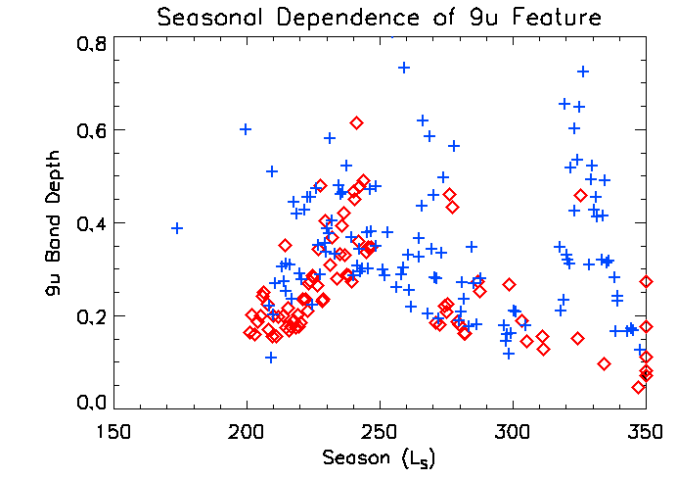
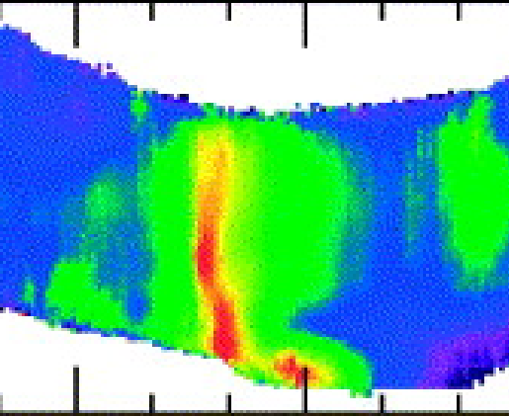
Results: Seasonal Dust
Do we see a change in opacity any time during the season?
Yes!
  In both years studied we see a
  steady rise in dust opacity from
  around 200 < L_{s} < 250
*Smith [2003]

Slide 15
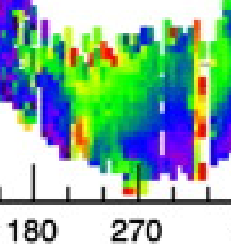
Results: Seasonal Dust
Do we see a change in opacity any time during the season?
Yes!
  In both years studied we see a
  steady rise in dust opacity from
  around 200 < L_{s} < 250
Evidence of dust storm penetration seen over polar regions
In MY 26 we even see signs of a global dust storm in our data
  Validates the EPF data
*Smith [2009]

Slide 16
Summary
Are EPFs a reliable and consistent way to measure atmospheric dust opacities over the South Pole?
    EPFs are consistent with previous data collection techniques
    EPFs work in colder regions where previous techniques fail
What kind of atmospheric dust opacity distribution do we see over the southern cap as it sublimes?
    Subliming cap lifts dirt into air increasing atmospheric dust opacity
    Global dust storms penetrate pressure zone altering distribution further

Slide 17




Acknowledgements
I’d like to give thanks to all of you for being here and a special thanks to:
  Dr. Timothy Titus with the USGS (My mentor)
  The Arizona Space Grant Consortium
  NAU Space Grant
  NASA

Slide 18
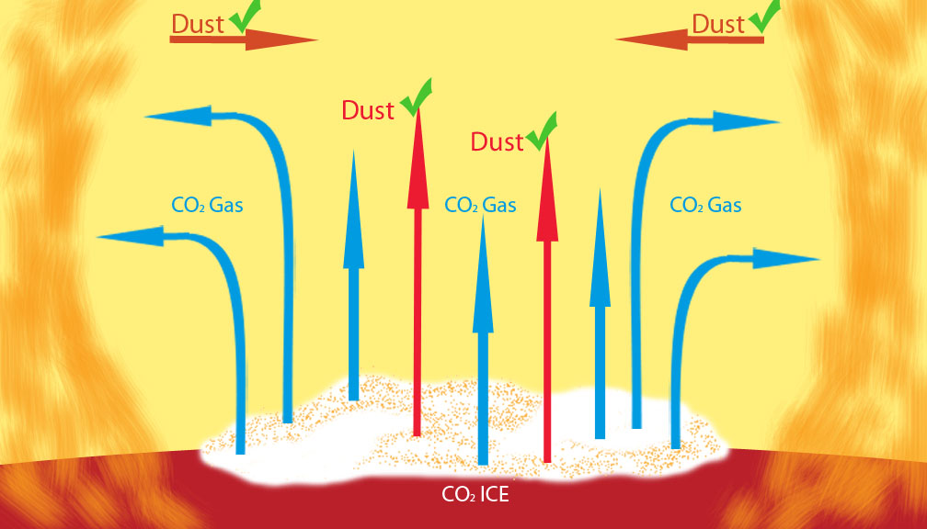
QUESTIONS?

